Slide 1
American History
1
Talk 27: Roaring Twenties (1921-1929)
Part Two

Slide 2
Roaring Twenties

Slide 3
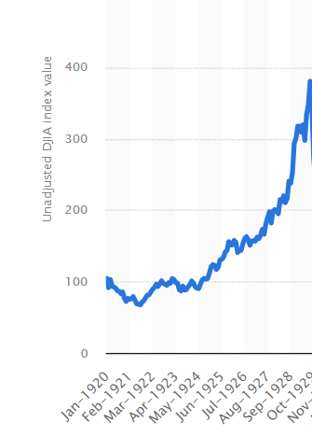
Economy booms
Economy grows 50%
..everyone more wealthy
(except farmers
Stocks rise 400%
 | Economic Growth
1921 | 0%
1922 | 6%
1923 | 13%
1924 | 4%
1925 | 2%
1926 | 6%
1927 | 1%
1928 | 1%
1929 | 6%

Slide 4
New products & services…consumer society …US takes off vs UK (except radios!)
 |  | 1920 | 1930
Houses with electricity | USA | 60% | 90%
 | UK | 30% | 50%
Houses with indoor plumbing | USA | 45% | 50%
 | UK | 20% | 50%
Radios/1000 people | US | 60 | 400
 | UK | 5 | 600
Telephones/1000 | US | 600 | 800
 | UK | 300 | 500
New jobs created faster than old jobs destroyed

Slide 5
Wages rising faster than prices
US wages highest in world (40% above those in UK)
Skilled Factory worker annual wages
1920 $1,500….£17,325 (2024)
1928 $2,200 …..$23,000 (2024)
Wages increase 40% , prices 10%
Affordable rising house prices 4 bedroom home, New York City
1920…$8,000 -$12,000
1928…$12,000 - $18,000
High payments…..Interest rates at 6%, 10 year terms

Slide 6
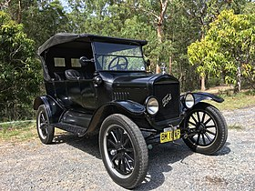
What made the US different: the automobile
Model & 1908-1927
…15 million made, 10,000 day
Henry Ford: mass production
& standardisation
Cars per 1000 people
 | 1920 | 1930
US | 86 | 200
UK | 22 | 35
Price reduced 75% over 9 years
………$750 in 1920 (£25,000 today)
………$275 1929 (£7,000)

Slide 7
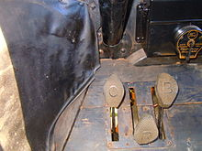
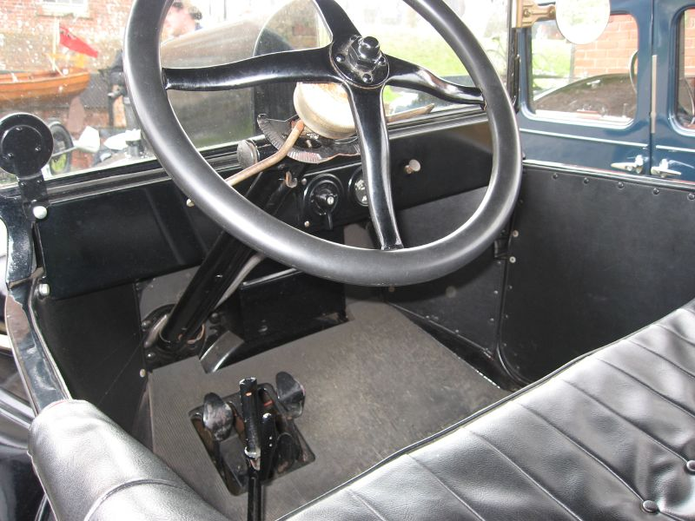
Model T driver controls …14 -20 hp …top speed 40 mph, Two gears,
3 pedals. Release, accelerator break

Slide 8
Automobile and Social Change
Increases wealth due to velocity of expenditure/ mobility
Urban spread….commuting possible, separation of communities
New jobs 1,000,000’s new well paid jobs replace blacksmiths, coach
handlers, stable hands, refuse removers
Improved health (London 300K horses 3 thousand tons manure per day)
Industrialised dating….absence of chaperones. Social barriers
Increased crime…improved mobility, exits, arrivals

Slide 9
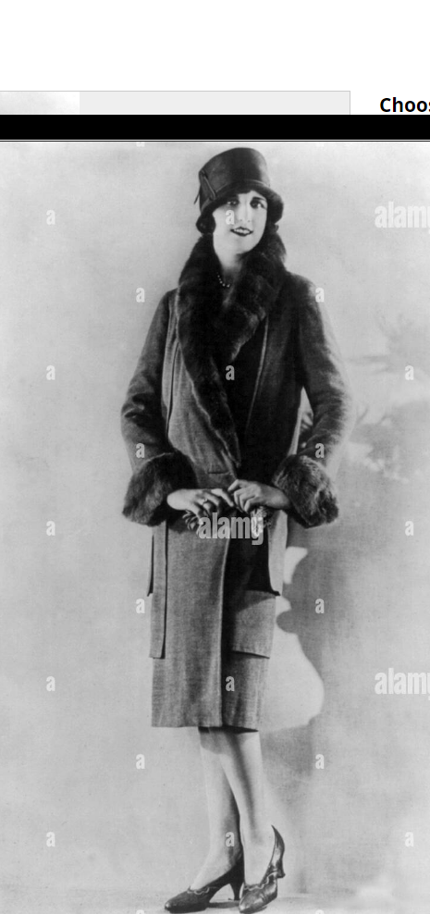
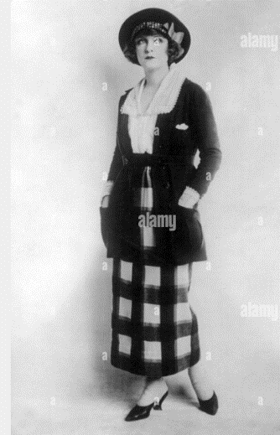
The new look….casual elegance and comfort

Slide 10
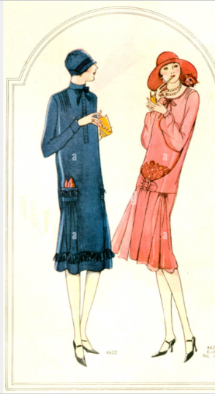
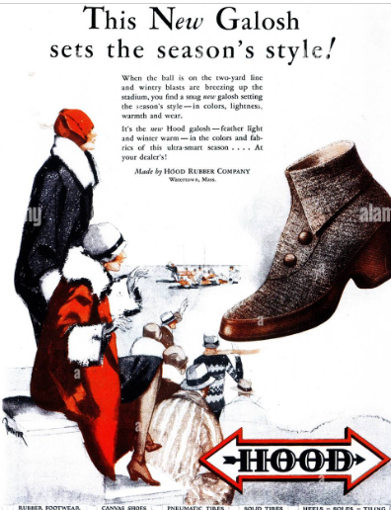
Consumer advertising….accessible fashion

Slide 11
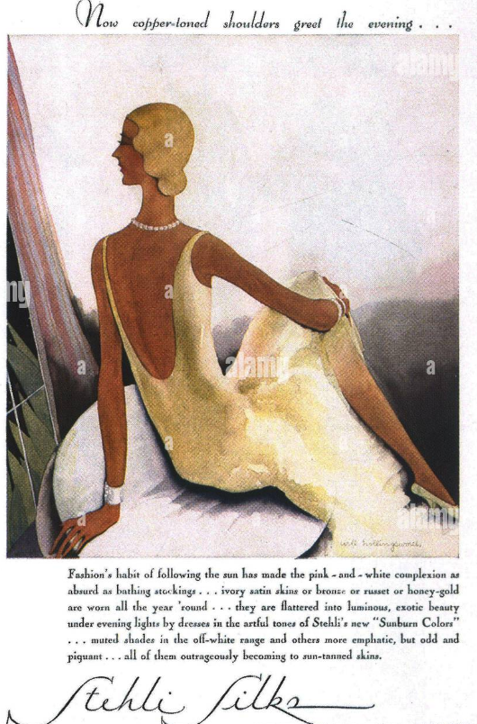
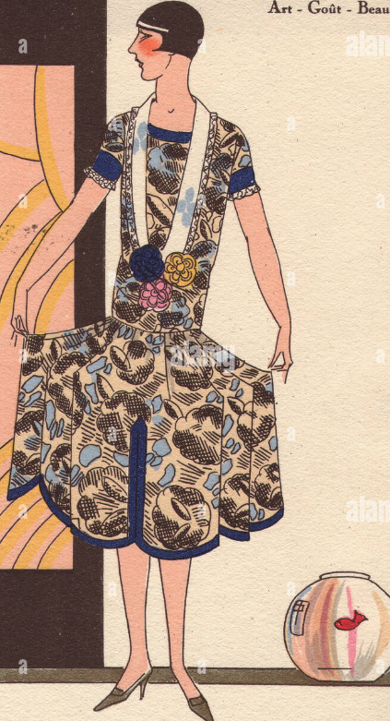
Colour, style, freedom

Slide 12
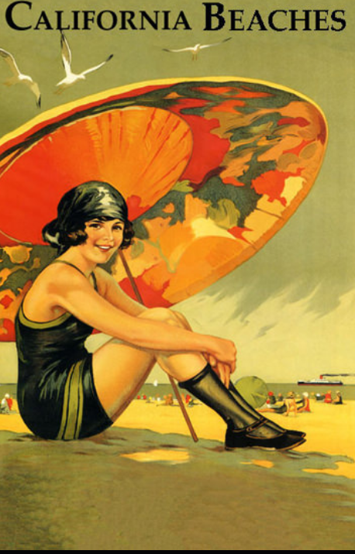
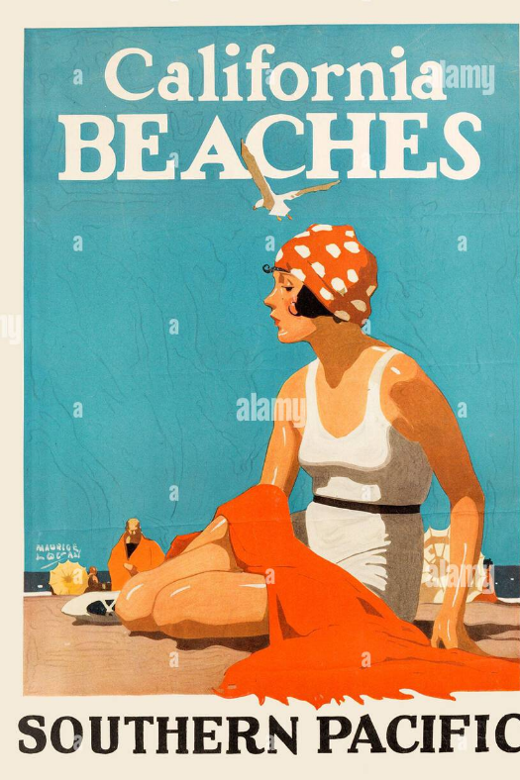
California look 1920

Slide 13
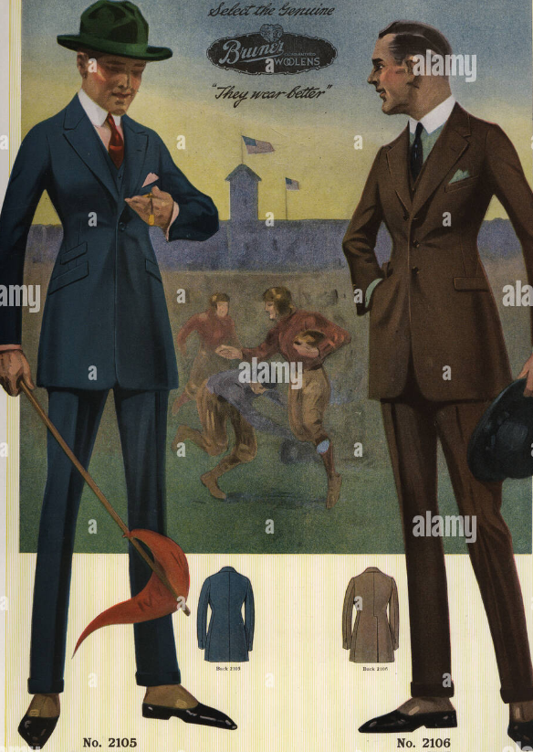
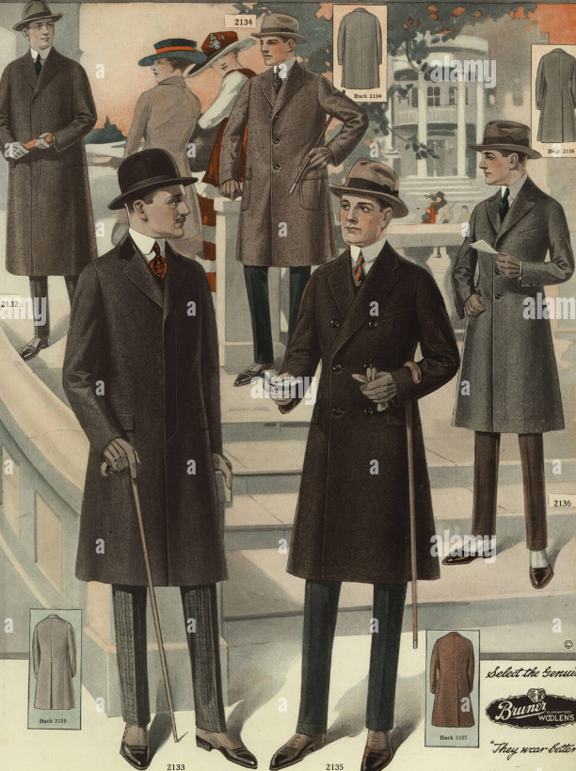
Men's fashions, smart, dark, comfort

Slide 14
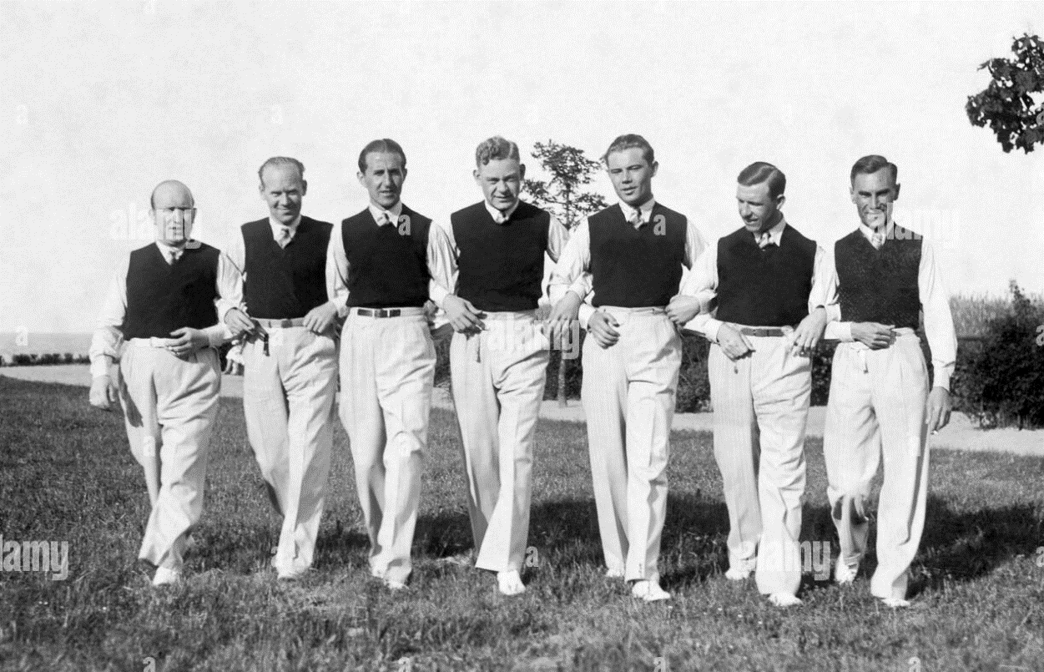
The casual look

Slide 15
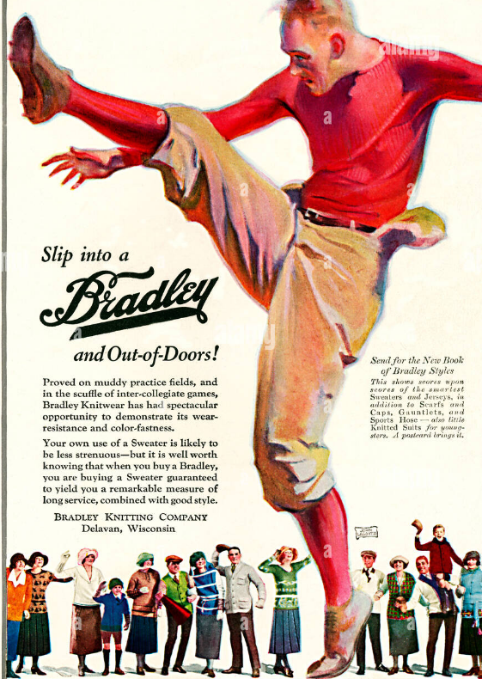
The football player look

Slide 16
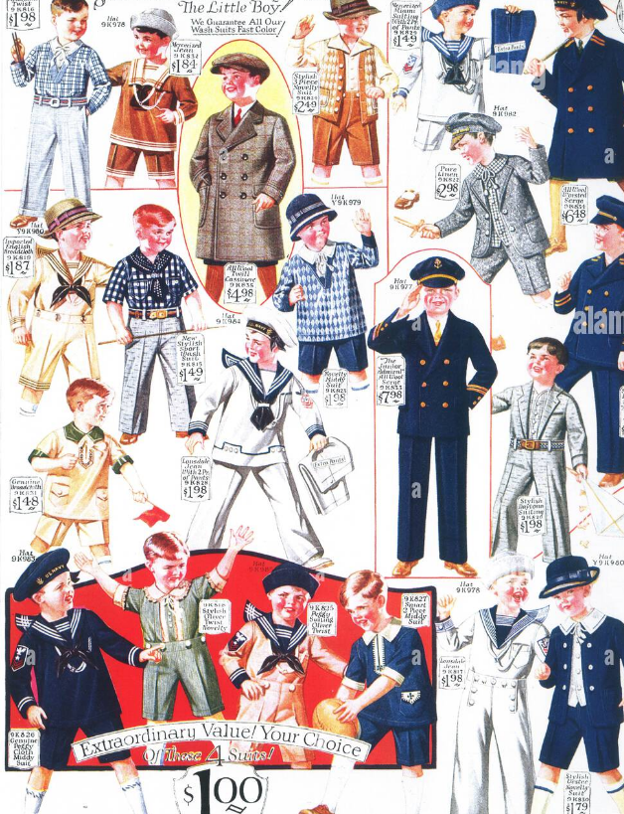
Children's clothes. New range

Slide 17
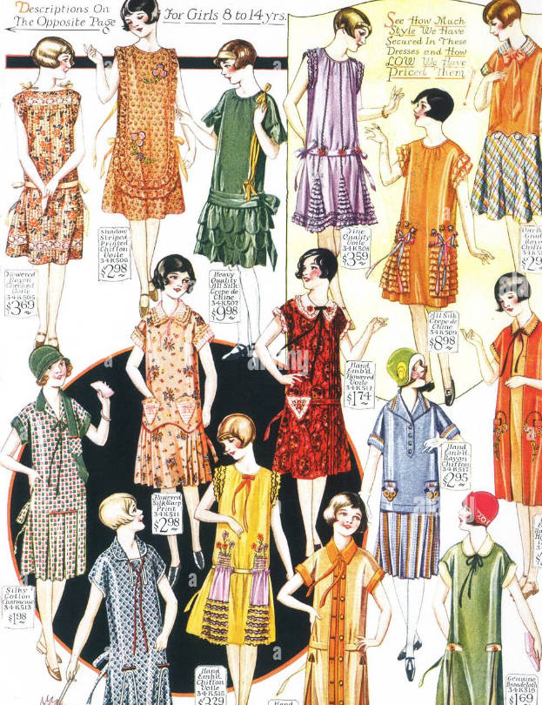
Girls too!

Slide 18
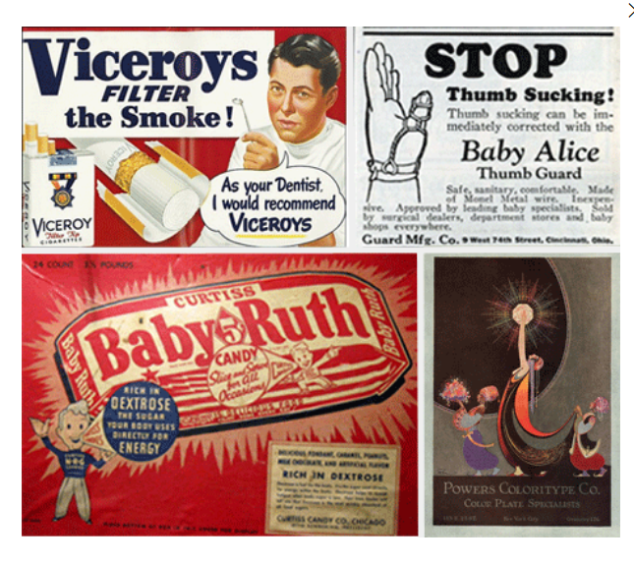
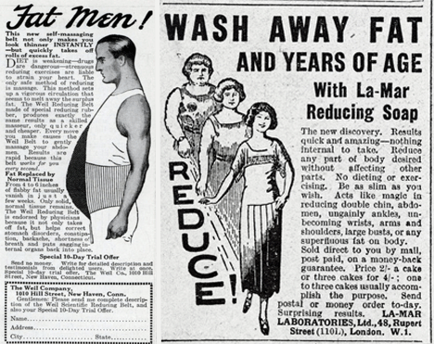
Mass advertising everything, everywhere

Slide 19
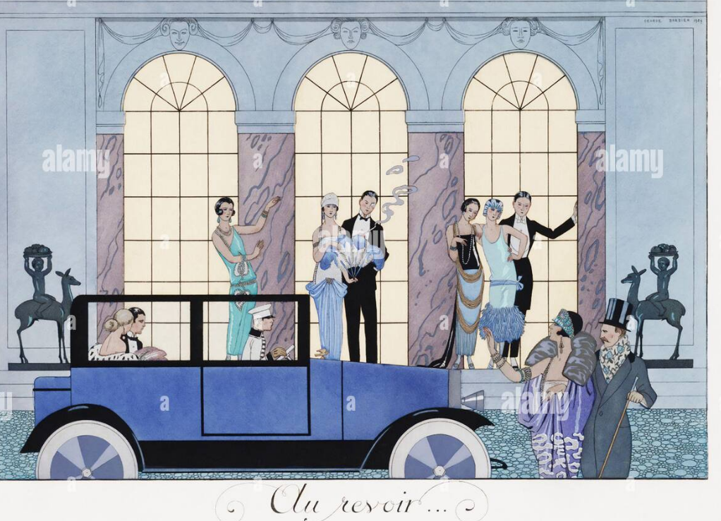
Cocktails after work? At the private club

Slide 20
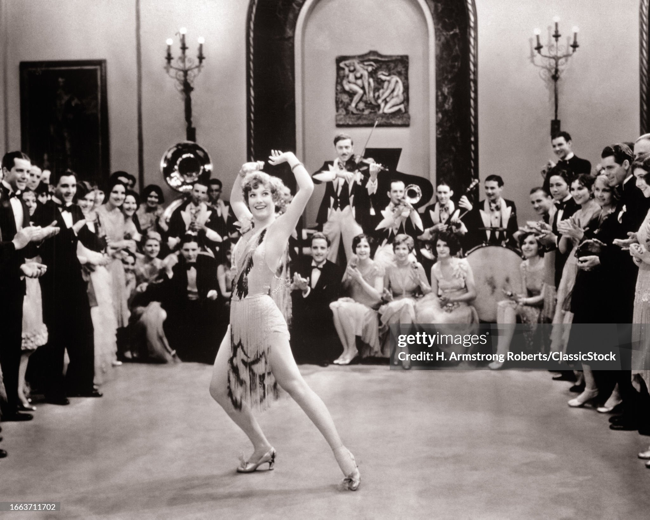
Celebrity culture: Joan Crawford dancing queen

Slide 21
Twenties woman in world dominated by men

Slide 22
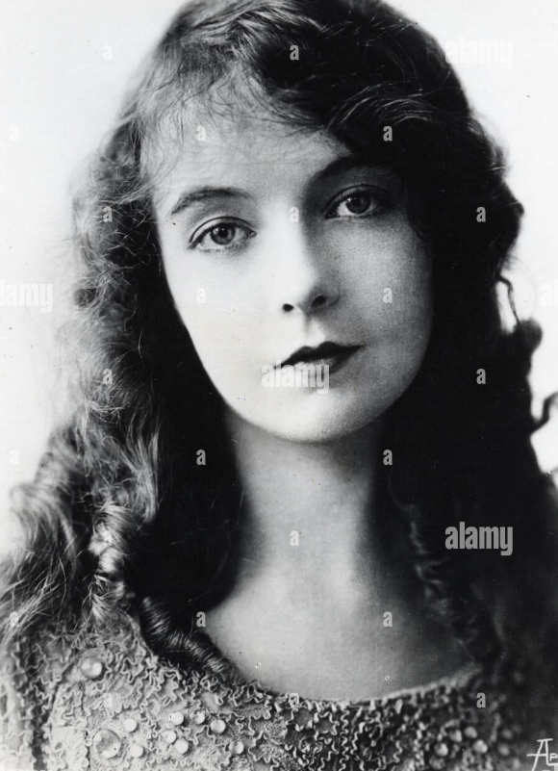
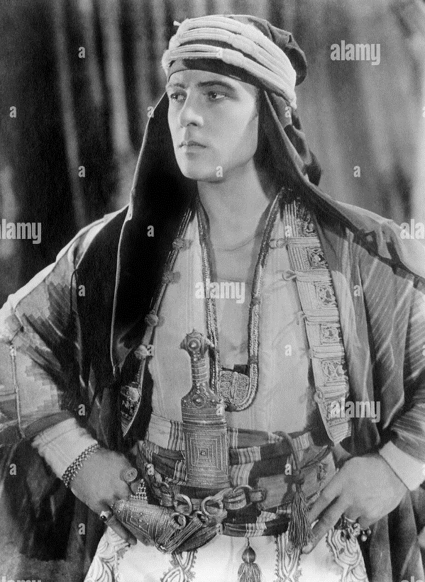
Silent movie stars
Lilian Ghosh
Rudolph Valentino

Slide 23
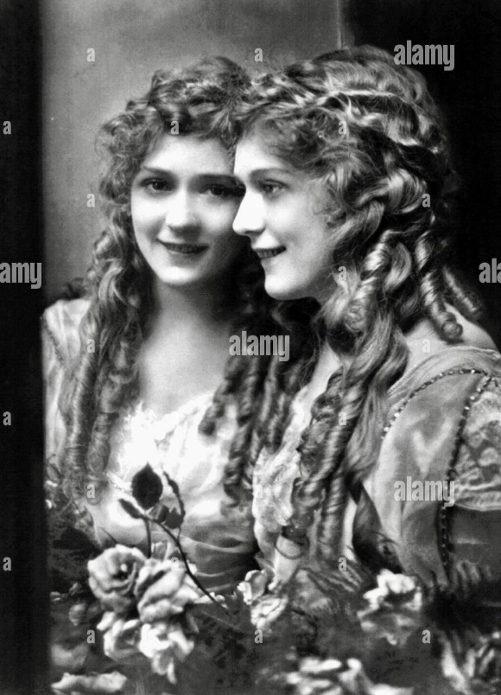
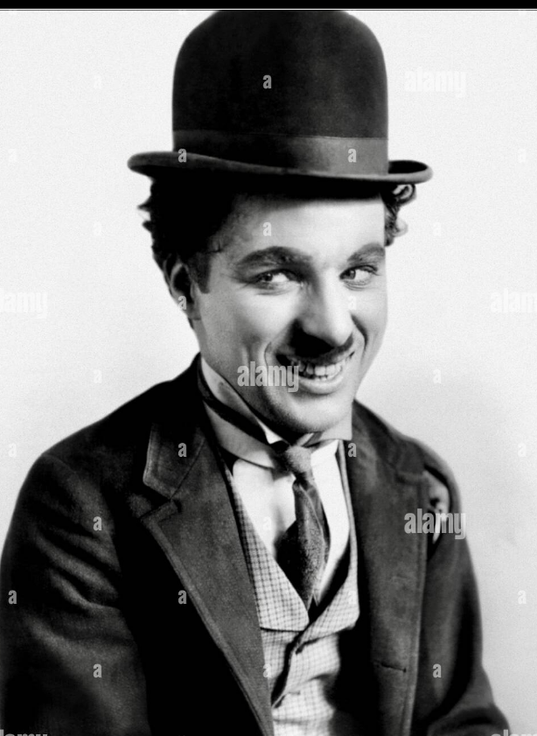
Silent movie stars
Mary Pickford
Charlie Chaplin

Slide 24
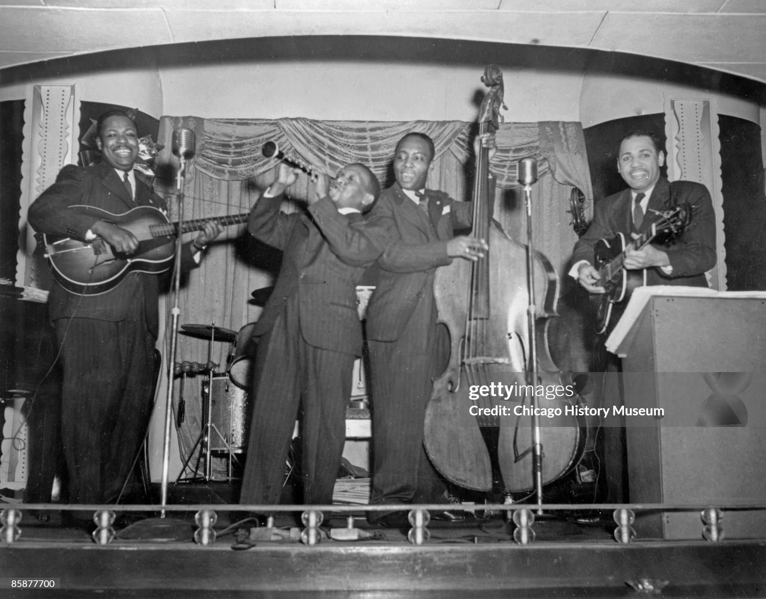
Jazz group Chicago 1925

Slide 25
Musical Interlude

Slide 26
Putting on the Ritz (Irving (Isiah) Berlin 1928)
Have you seen the well to do
Up on Lenox Avenue
On that famous thoroughfare
With their noses in the air?
High hats and Arrow collars
White spats and fifteen dollars
Spending every dime
For a wonderful time
If you're blue, and you don't know where to go to
Why don't you go where Harlem flits?
Puttin' on the Ritz
wonderful time
If you're blue

Slide 27
Spangled gowns upon the bevy of high browns
From down the levy, all misfits
Putting' on the Ritz
That's where each and every lulu-belle goes
Every Thursday evening with her swell beaus
Rubbin' elbows
Come with me and we'll attend their jubilee
And see them spend their last two bits
Puttin' on the Ritz
`

Slide 28
Have you seen the well to do
Up on Lenox Avenue
On that famous thoroughfare
With their nose in the air?
High hats and Arrow collars
White spats and fifteen dollars
Spending every dime
For a wonderful time
If you're blue, and you don't know where to go to
Why don't you go where Harlem flits?
Puttin' on the Ritz

